Slide 1
OpenCL vs: Accelerated Finite-Difference Digital Synthesis
Harri Renney & Benedict R. Gaster
Computer Science Research Centre
Tom Mitchell
Computer Science and Creative Technologies
Notes:
Introduce the paper.
Highlight Ben, Tom and UWE.
What was set out to accomplish. *An FDTD synth using OpenCL(New) *Implement and compare other methods.

Slide 2
Motivation
Notes:
What was the motivation for this project?
Lay foundations to establish importance of accelerating this application.

Slide 3
Quality Sounds
Notes:
Producers want a bigger pallet of instruments/sounds.
Producers want control.
Physical models open up bigger pallet.

Slide 4
Intensive Music Production
Notes:
Present a DAW. A producers software.
Currently, CPU is allocated these intensive tasks.
In this kind of situation, GPU is sitting idle.

Slide 5
Background
Notes:
Cover background of things to be aware of for project.

Slide 6
Digital Audio
Real-Time
Offline Storage
Notes:
Digital Sound = Represented digital form. Encoded as samples in sequence.
Real-time = Samples generated & played immediately.
Performance requirements: Minimum 44.1Khz sample rate, 10ms latency.
Offline = Samples generated over time & stored for later.
Metaphor = Game rendering vs film CGI

Slide 7
Physical Modelling
Simple 1D String Physical Model: Karplus and Strong’s String Synthesis
2D Vocal Tract: Digital Waveguide Synthesis
Notes:
Physical models, one of many different types of synthesis.
Way of modelling & simulating systems containing physical components.
Some are more pure/numerical physical models.
Karplus and Strong’s = Popular simple algorithm used as introduction.
Digital waveguides = Ideas from physics wave propagation.

Slide 8
Physical Modelling: Direct Numerical Simulation
Applied Mathematics
Computer Program
Notes:
Most pure physical models are direct numerical simulations.
Literal application of applied mathematics to represent instruments.
Straightforward FDTD approximation for set of differential equations.
Real-time computation expensive. Usually offline.
Alternatives: finite-element, finite-volume

Slide 9
Finite-Difference Time-Domain
Finite difference methods represent differential equations.
Time-stepping creates simulation over time.
Notes:
FD methods way of representing differential equations in model to solve.
Incorporating time stepping, simulate change over time. FDTD.
Initial state, time-step length, differential equation, grid, edge conditions.
Foundational mathematics trace back to origins of fluid dynamics and electromagnetics.

Slide 10
Design & Implementations
Notes:
Introduce design of the implementations for benchmarking & comparison.

Slide 11
Physical Model: 2D Drumhead Membrane
Notes:
Drumhead model use discretized standard 2D wave equation.
Simulates propagation of pressure through membrane.
Edge condition at edge of drumhead. (Reflection)
Propagation coefficient = Speed waves pass through material.
Damping coefficient = Degree of wave absorption in material.
Excitation input.
Samples output.

Slide 12
General Architecture
$$P_{c}^{n+1}=calculate(P_{c}^{n−1}, P_{c}^{n}, P_{l,r,u,d}^{n})$$
$$P_{u}^{n}$$
$$P_{c}^{n−1}$$
$$P_{l}^{n}$$
$$P_{c}^{n}$$
$$P_{r}^{n}$$
$$P_{c}^{n+1}$$
$$P_{d}^{n}$$
Grid at time: n-1
Grid at time: n
Grid at time: n+1
Notes:
Grid must be stored in data structure.
Grid holds pressure values.
Explain time steps.
Explain equation.
A convolution of neighbours.
2D Wave Equation
Data structure and access patterns of grid effects performance.

Slide 13
The Difference Equation
$p^{n+1}= \frac{2p^{n}+\left(μ−1\right)p^{n−1}+ α(p_{l}+p_{r}+ p_{u}+ p_{d} −4p^{n})}{μ+1}$
(Walstijn & Kowalczyk, 2008)
$P_{L,R,U,D}= \left\{\begin{aligned}p^{n}γ \\ p_{l,r,u,d}^{n}\end{aligned}\right.$
if n boundary
if n free
$$p^{n+1}$$
$$p^{n}$$
$$p^{n−1}$$
$$μ$$
$$α$$
$$p_{l, r, u, d}$$
$$γ$$
= Pressure next time step
= Pressure current time step
= Pressure previous time step
= Damping coefficient $\left(0.0 < μ <1.0\right)$
= Propagation coefficient $\left(α≤0.5\right)$
= Pressure neighbours
= Boundary gain $\left(0.0 < γ <1.0\right)$
Notes:
Show 2D Wave Equation.
Relate terms from past slides to equation.
Damping coefficient = The amount of energy absorbed by material as travels.
Propagation coefficient = the speed the pressure travels through model.
Boundary gain = The degree the pressure is reflected back into model.

Slide 14
GPU Acceleration
CPU Initialization
CPU Playback
GPU Process
Notes:
CPU initializes the grid. Defines the boundaries/edges, material and in/out positions.
CPU playback inputs excitations, enqueues a batch of time step on GPU.
GPU processes a batch of time steps, recording the output samples to buffer

Slide 15
Version: CPU Serial
Cache Alignment:
Avoiding Copies:
Redundant Calculations:
Notes:
Serial = Visits each point in turn. Calculates pressure in sequence.
If grid dimensions increase together, exponential increase in complexity.
Cache alignment = Flattened 2D array for grids. Reduces cache misses at edges.
Avoiding copies = Avoid copies of whole grids through time-steps. Using pointers to grids.
Redundant calculations = Calculations moved outside loops.

Slide 16
Version: CPU AVX
Vector Multiply
Vector Store
Vector Load
Notes:
Incorporates vectorization of grid for AVX technology on CPU.
Intel’s AVX compiler intrinsics. Low-level required.
Alternatives high level libraries/#pragmas
AVX-128 width. Max 4 floats processed in parallel.
Max ideal speedup X4.
Better implementation would use all CPU cores AXV tech.

Slide 17
Version: GPU OpenGL
Design proposed by (Zappi et al, 2017)
Pixel: RGBA Channel
P
P-1
isBoundary
isExcitation
Model stored as texture
Notes:
Novel single graphics texture.
Using graphics pipeline.
FDTD values stored in texture colour channels.
Interesting, but creates problems. Whole texture read/write. So no opportunity to optimize.
Recent versions of OpenGL have compute shaders for GPGPU.

Slide 18
Version: GPU OpenCL
General Purpose GPU (GPGPU)
(Harris, 2012)
Global Workspace (Kernel)
Local Workspace (Workgroup)
Private Workspace (Work-item)
Notes:
Contrast to OpenGL graphics API. OpenCL is GPGPU.
Mark Harris
Highlight the GPGPU memory hierarchy.
Provides opportunity to optimize.

Slide 19
Version: OpenCL Global & Local
Purely global memory version
Local memory version
Notes:
There is a version using only the global memory.
There is a version utilizing faster local memory for grid accesses. Involves conditionals.

Slide 20
Version: Overview
FDTD Synthesis Implementations
CPU Serial
CPU AVX
GPU OpenGL
GPU OpenCL Global
GPU OpenCL Local
Notes:
Just run over all the different versions

Slide 21
Common Mechanism: Rotation Index
Notes:
Used through all implementations.
Method of incrementing pointer to grids when time-stepping.
Avoids copying these potentially huge grids.

Slide 22
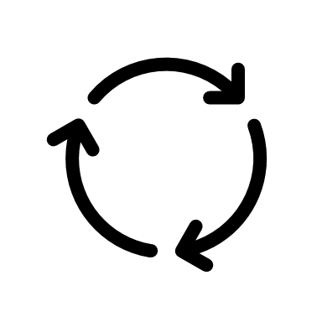
Common Mechanism: Input/Output Buffer
Input Excitation:
Repeats for buffer length
Output Samples:
Notes:
Used through GPU implementations.
Buffer input to excite.
Repeat time-steps for all input buffer.
Fill output buffer generated samples.
Batching avoids CPU – GPU transfer overhead.

Slide 23
OpenCL Workgroup Optimizations
Notes:
Optimization commonly used convolutionary neural networks.
Utilizes faster local memory.
If in workgroup – Local access else – Global access
Details in paper.

Slide 24
Benchmarking
Control Parameters: Input/Output Buffer Size = 512
Independent Variables: Grid Dimensions, Workgroup Dimensions
Dependant Variables: Computation Time
Notes:
Control parameters = Input/Output buffer sizes.
Independent variable changed = Grid dimensions. Workgroup dimensions.
Dependant variable measured = Compute Time.
Outline spec of benchmarked system. Basic, mid-range work laptop.

Slide 25
Results: Workgroup Dimensions
Notes:
Results for varying the OpenCL workgroup dimensions.

Slide 26
Compute time up to wavefront size
Time per 512 samples.
Notes:
4*4 = 16, 8*8 = 64, 16*16 = 256
Fits expectation. AMD Radeon 530 reported wavefront/thread size 64.
Small detail, number work items executed parallel by compute unit.
Workgroup size smaller wastes wavefront potential.

Slide 27
Compute time past wavefront size
Time per 512 samples.
Notes:
4*4 = 16, 8*8 = 64, 16*16 = 256
Increasing past 64 benefits from larger local memory accesses.
So OpenCL local benefits but Global does not benefit from this increased space.
Optimizations possible by targeting spec of specific devices.

Slide 28
Results: Model Dimensions
Notes:
Results for varying the model dimensions.

Slide 29
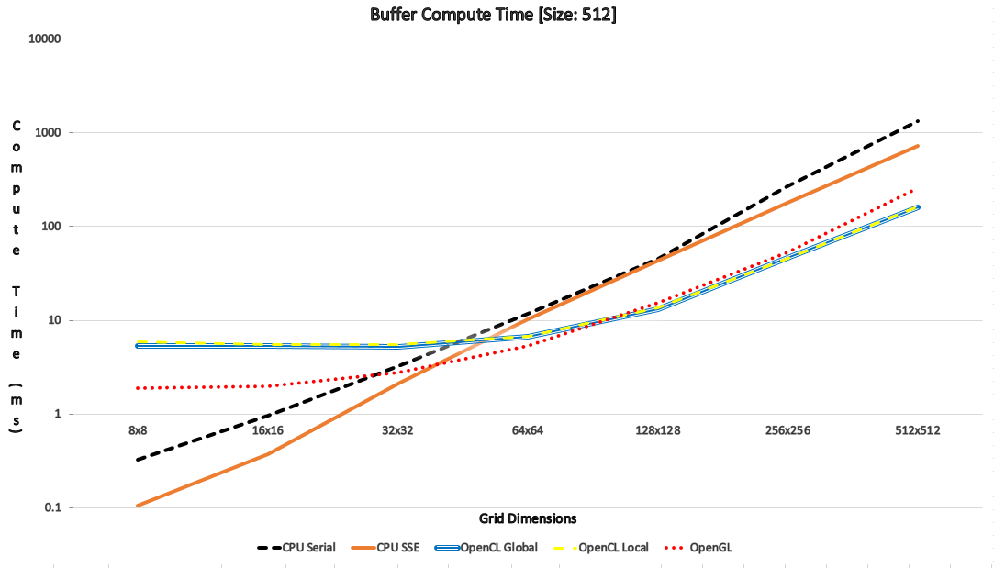
Compute time at smaller dimensions
Notes:
Explain axes - Graph measures compute time to grid dimensions.
Logarithmic Scale. So scaling exponentially.
CPU vs GPU
Small dimensions = CPU faster. - GPU transfer overhead exceeds benefit.

Slide 30
Compute time at higher dimensions
Notes:
Large dimensions = GPU faster. – Speed of massively parallel device exceeds transfer cost.

Slide 31
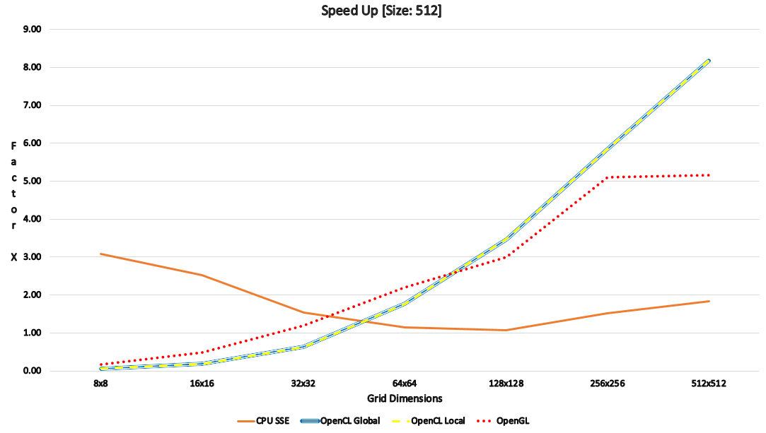
Speedup of AVX
Notes:
Avx at a 3X speedup which is close to the expected ideal case of 4X.
Overtime, seems to come down and fluctuate between 1X & 2X
Overhead involved using AVX tech.

Slide 32
Speedup of OpenGL
Notes:
Explain Axes – Measures speedup in relation to CPU serial for grid dimensions.
OpenGL begins slightly faster.
As scales, OpenCL exceeds OpenGL.
OpenCL & OpenGL Implementations quite different.
OpenCL more flexible for general purpose.
OpenGL constrained to graphics.
OpenGL novel single texture structure.

Slide 33
Speedup of OpenCL
Notes:
Global and local optimization in OpenCL kernel. Very similar times, considered negligible.
Hypothesis = Performance gain cancelled out by workgroup edge conditionals.
Branching in GPUs is bad as execute in lockstep.
Shared memory bank conflicts.
Possible to improve this further.

Slide 34
Conclusion

Slide 35
Project Outcomes
Designed & developed an OpenCL FDTD Synthesizer.
Compared different methods of implementing an FDTD synthesizer.
Analysed performance results and reviewed implementations.
Foundations set for further investigation and development in GPGPU.
Notes:
Only recorded total performance time.
CPU handles smaller, GPU larger dimensions. Reinforces idea that each suited for specific situations.
OpenCL best, but OpenGL method was novel.
Workgroup optimizations interesting, but negligible benefit.

Slide 36
Future Work
Investigating another method for GPGPU, Vulkan. (Sellers et al, 2016)
Developing a comprehensive benchmarking suite to compare OpenCL and Vulkan.
Benchmarking on a broader range of systems.
Notes:
Investigate relatively new graphics API Vulkan.
Benchmark on professional kit. E.g. GTX 1070
Benchmarking suite. Arithmetic, memory, applications, etc. Including micro & macro benchmarks.

Slide 37
References
[1] Zappi, V., Allen, A. and Fels, S., 2017. Shader-based physical modelling for the design of massive digital musical instruments. In NIME (pp. 145-150).
[2] Harris, M., 2012. GPGPU. org. http://gpgpu. org.
[3] Sellers, G. and Kessenich, J., 2016. Vulkan programming guide: The official guide to learning vulkan. Addison-Wesley Professional.
[4] Maarten Van Walstijn and Konrad Kowalczyk. 2008. On the numerical solution of the 2D wave equation with compact FDTD schemes. Proc. Digital Audio Effects (DAFx), Espoo, Finland (2008), 205–212.

